Slide 1
graphs

Slide 2
Problems solved with graphs

Slide 3
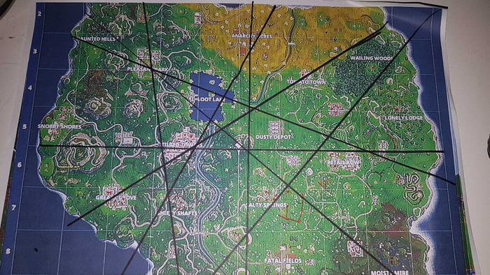
Transportation or shortest path problems
How can I get to all the treasure chests quickly before others
(Fortnite)

Slide 4
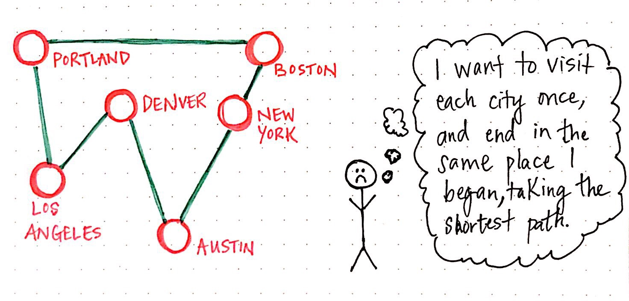
Transportation or shortest path problems
Traveling Salesman Problem

Slide 5
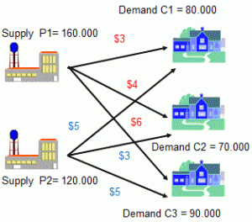
Transportation or shortest path problems
How to move a single product from several sources to several destinations at a minimum cost.

Slide 6
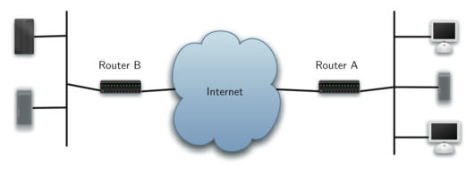
Transportation or shortest path problems

Slide 7
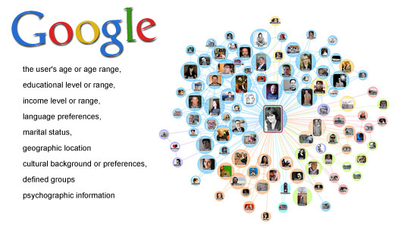
Social & Economic networks

Slide 8
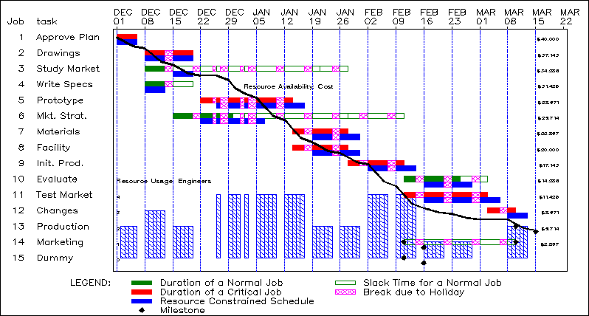
Project scheduling

Slide 9
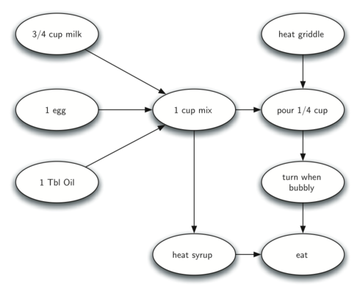
Topological sorting

Slide 10
Graph vocabulary

Slide 11
Graph vocabulary
Vertex – also called a node – it can contain a name (called the “key”) and can also have additional information.
Edge – also called an arc – connects two vertices to show that there is a relationship between them.

Slide 12
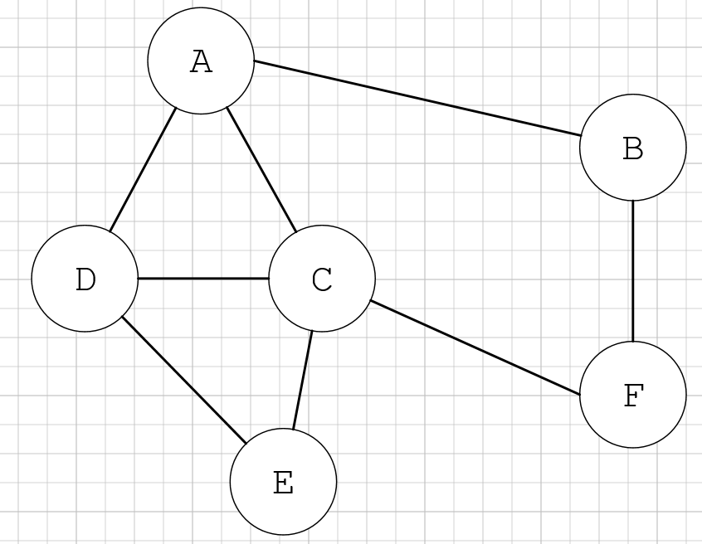
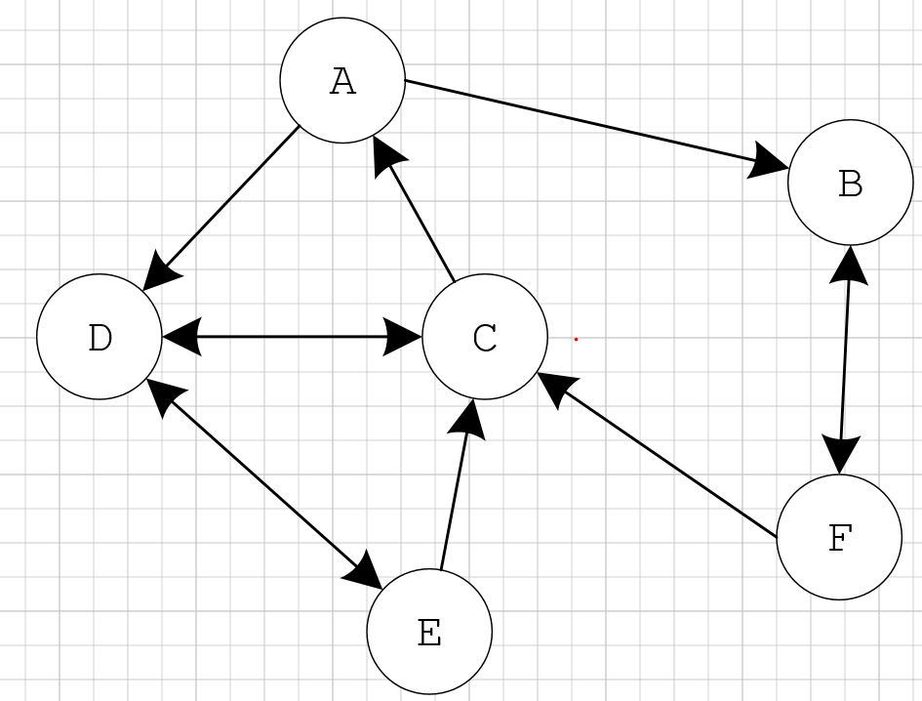
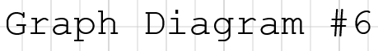
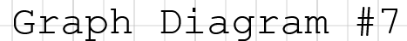
Graph vocabulary
Directed graph (digraph) – the edges have arrows showing a direction of the relationship
Undirected graph – the edges have no arrows, meaning that the edges are all two-way relationships.
UNDIRECTED
GRAPH
DIRECTED
GRAPH
(DIGRAPH)

Slide 13
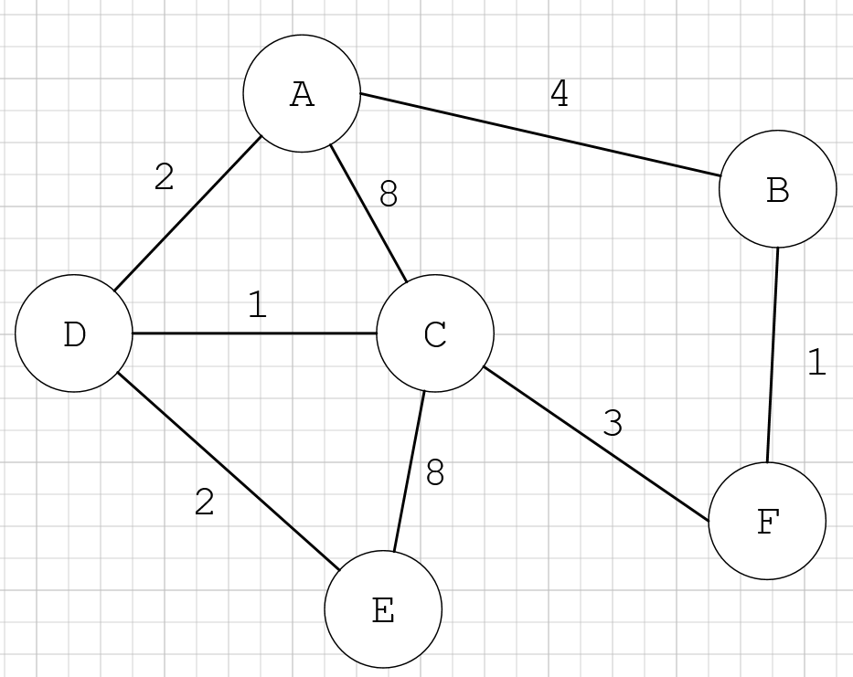
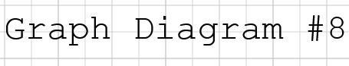
Graph vocabulary
Edges may be weighted to show that there is a cost to go from one vertex to another. A weighted graph may be directed or undirected.
Example: flight cost between airports, connection speed between computers, or travel time between cities.

Slide 14
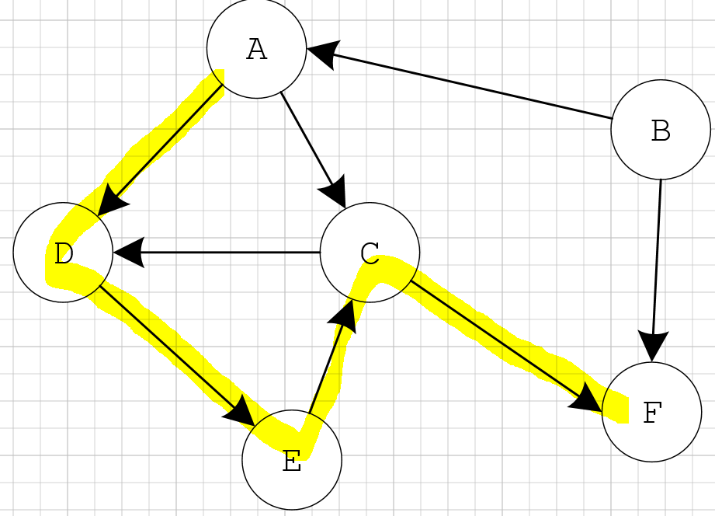
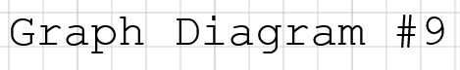
Graph vocabulary
Path – a sequence of vertices that are connected by edges.
The path from A to F is the sequence of vertices A, D, E, C, F.

Slide 15
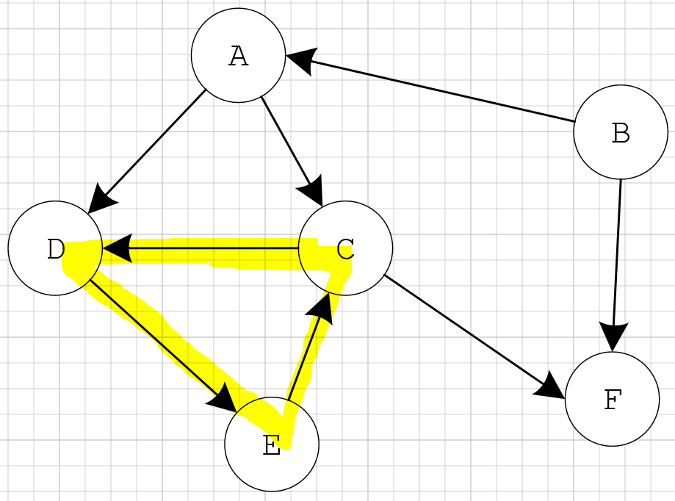
Graph vocabulary
Cycle – a path that starts and ends at the same vertex.
Example: the path (C, D, E, C) is a cycle.

Slide 16
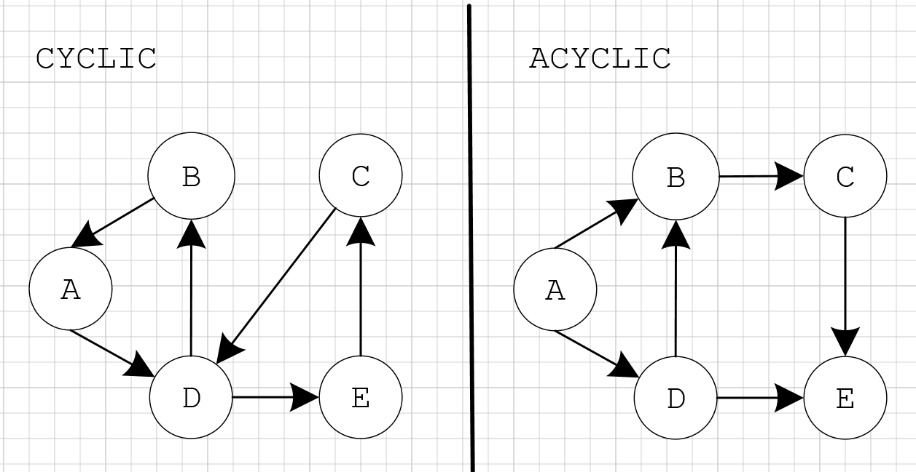
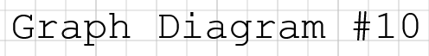
Graph vocabulary
CYCLIC vs. ACYCLIC
A directed graph is cyclic if the graph contains at least one cycle, and acyclic if the graph does not contain a cycle.

Slide 17
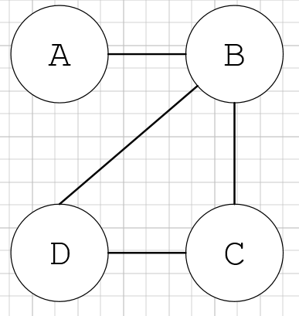
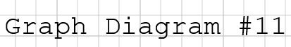
Graph vocabulary
Adjacent – two vertices are adjacent if connected by an edge.
Example: Vertex A is adjacent to Vertex B and Vertex D is adjacent to vertex B and C.

Slide 18
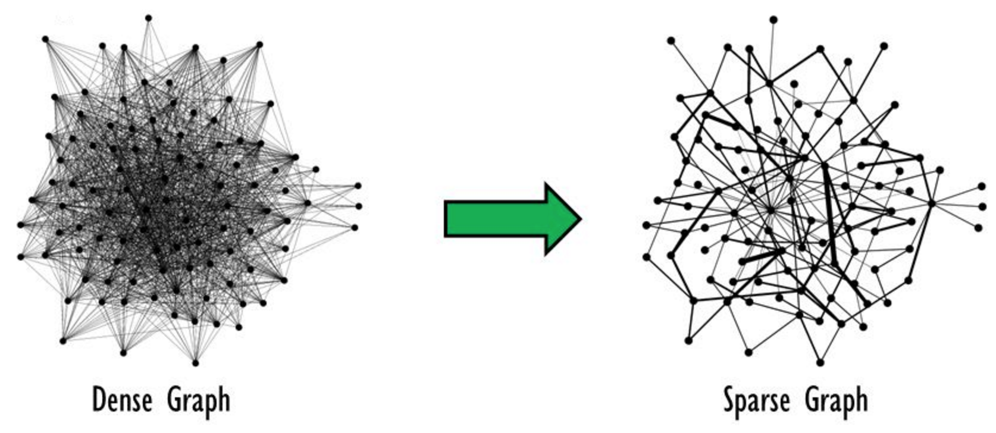
Graph vocabulary
Sparse graph – a graph that has far fewer edges than the maximum possible
Dense graph - a graph in which the number of edges is close to the maximum number of edges.

Slide 19
Graph representations

Slide 20
Graph representations
In order to use a graph in a program, you need a way to represent the graph. This is done in one of two ways:
Adjacency List
Adjacency Matrix

Slide 21
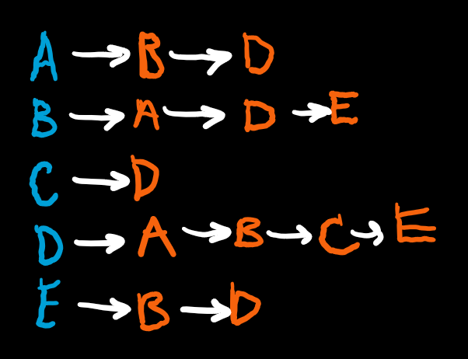
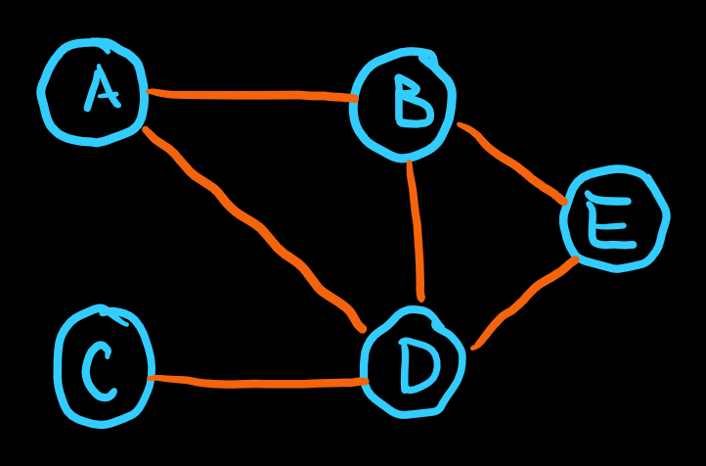
Graph Representation – adjacency list
In an adjacency list graph representation, each vertex has a list of adjacent vertices, each list item representing an edge.

Slide 22
Graph Representation – adjacency matrix
In an adjacency matrix, each vertex is assigned to a matrix row and column, and a matrix element is 1 if the corresponding two vertices have an edge or is 0 otherwise.
 | A | B | C | D | E
A | 0 | 1 | 0 | 1 | 0
B | 1 | 0 | 0 | 1 | 1
C | 0 | 0 | 0 | 1 | 0
D | 1 | 1 | 1 | 0 | 1
E | 0 | 1 | 0 | 1 | 0

Slide 23
Graph representation trade-offs
ADJACENCY LIST
Space usage (size) is V + E (not bad for sparse graphs)
Testing whether two vertices are adjacent takes O(V)
ADJACENCY MATRIX
Space usage is V² (not great)
Faster at testing whether two vertices are adjacent to each other – constant time O(1)

Slide 24
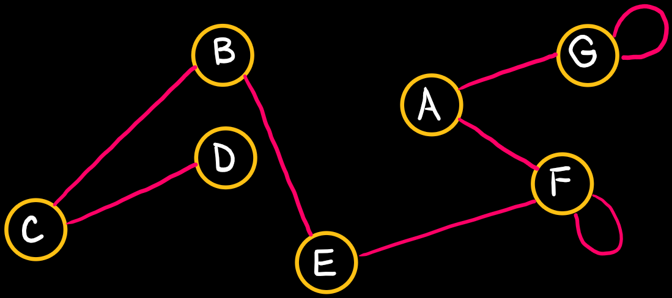
In-Class Practice 1
Draw the Adjacency List and Adjacency Matrix of the following undirected graph:

Slide 25
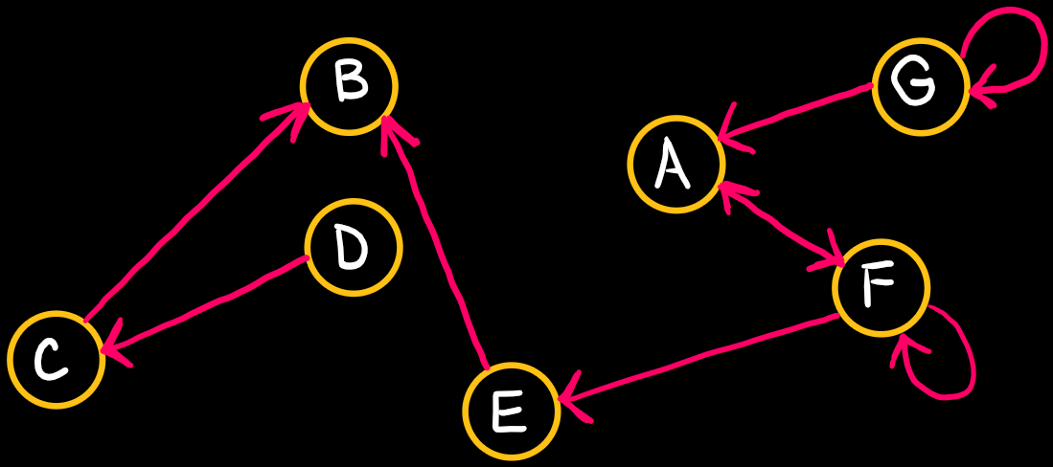
In-Class Practice 2
Draw the Adjacency List and Adjacency Matrix of the following directed graph:

Slide 26
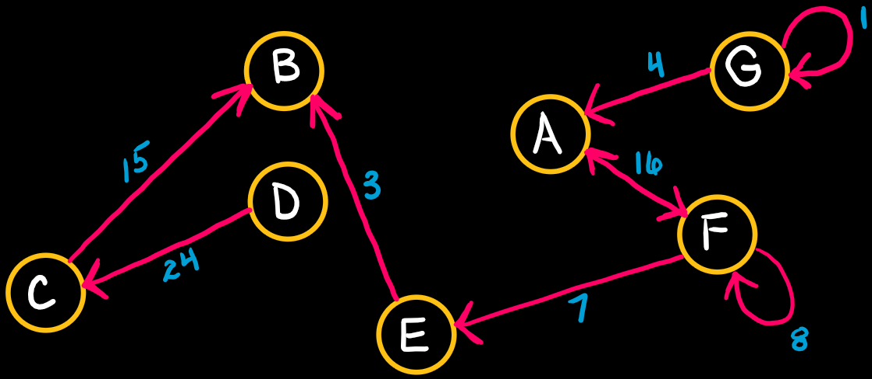
In-Class Practice 3
Draw the Adjacency Matrix of the following directed, weighted graph:

Slide 27
Adjacency list implementation
To implement an adjacency list in C++, you should create a GraphList class with the following attributes:
A ListNode structure (for the linked list for each vertex), which should have:
value member (vertex name – typically an integer)
pointer to the next ListNode.
A pointer to an array of pointers to ListNodes: ListNode** headArray;
An integer holding the number of vertices.
An integer holding the number of edges.

Slide 28
Adjacency list implementation
The GraphList class should have the following functions:
Constructor – an integer should be sent to the constructor that contains the number of vertices in the graph. In the constructor the “numVertices” attribute should be set to this number. “numEdges” should be set to zero. The array of pointers to ListNodes should be dynamically allocated and each element of this array should be set to NULL.
Destructor – delete all nodes in each linked list
AddEdge – Input is two integers, which indicate the adjacent vertices. Create the ListNode. Using the index value as the vertex name, traverse the linked list at that index and append the node.
PrintGraph – traverse through the array of vertices and traverse through the linked list at each vertex to print out the value.

Slide 29
Adjacency MATRIX implementation
To implement an adjacency matrix for in C++, you should create a GraphMatrix class with the following attributes:
A pointer to an array of pointers to integers: int** vertexMatrix; [this will be a dynamically allocated 2D array created in your comstructor]
An integer holding the number of vertices.
An integer holding the number of edges.

Slide 30
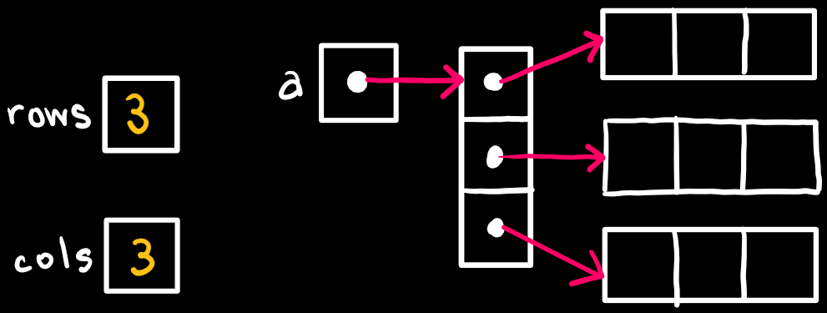
Adjacency MATRIX implementation
The GraphMatrix class should have the following functions: Constructor – an integer should be sent to the constructor that contains the number of vertices in the graph. In the constructor the “numVertices” attribute should be set to this number. “numEdges” should be set to zero. Dynamically allocate a 2-D array and set all elements to zero.
Example on how to dynamically allocate a 2D Array. In a Graph Adjacency Matrix, the number of rows & columns will be the same.
int** a = new int*[rows];
for(int i = 0; i < rows; i++)
a[i] = new int[cols];

Slide 31
Adjacency MATRIX implementation
The GraphMatrix class should have the following functions:
Destructor – delete all nodes in each linked list
AddEdge – Input is two integers, which indicate the adjacent vertices. If this element is equal to zero, then increment the number of edges and then set this element to 1.
DeleteEdge – Input is two integers, which indicate the edge that should be deleted. If the element is not equal to zero, then decrement the number of edges. Then, set this element to 0.
PrintGraph – print the values in the 2D Array

Slide 32
Breadth-First Search Depth-First Search

Slide 33
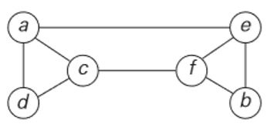
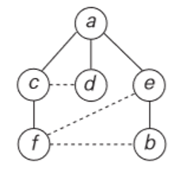
Breadth-first search (BFS) Algorithm
A traversal for the cautious – algorithm stays closer to “home”
Start at a vertex
Visit all vertices adjacent to start vertex
Visit all unvisited vertices two edges away from start vertex and so on, until all vertices are visited.
Use a QUEUE to trace the operation of BFS

Slide 34
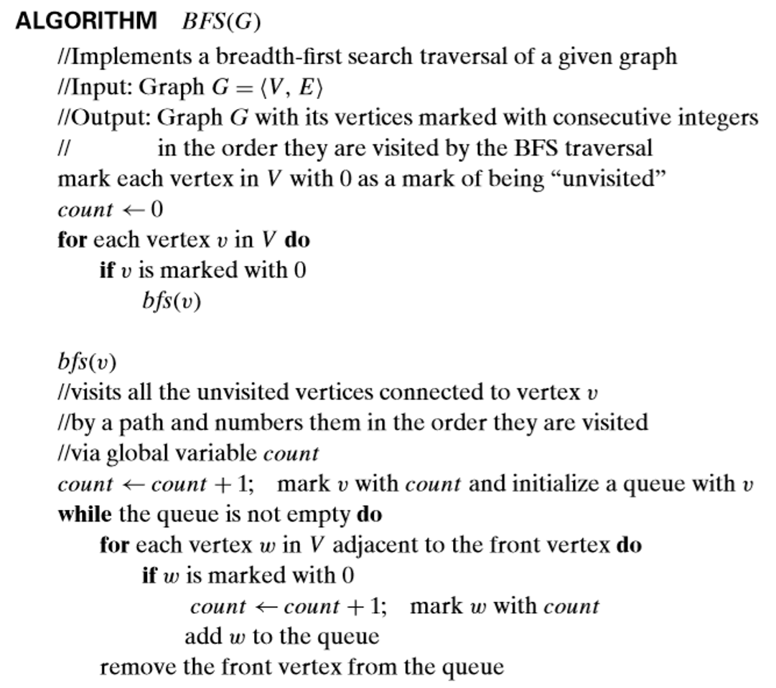
Breadth- first search (BFS) Algorithm

Slide 35
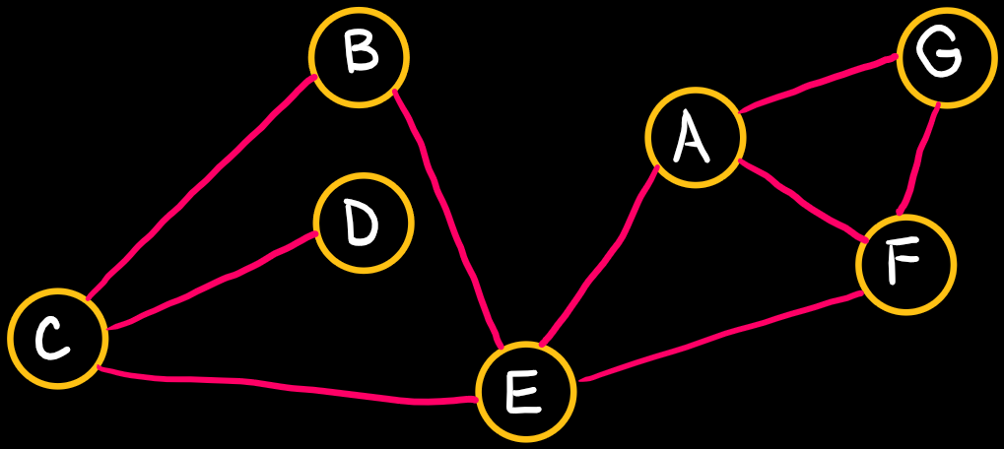
In-Class Practice 4
What is the order that these vertices are visited when starting with vertex ‘A’, using BFS method of traversal, and resolving ties alphabetically?

Slide 36
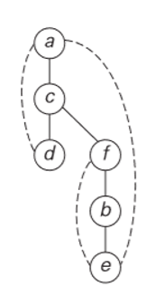
DEPTH-FIRST search (DFS) Algorithm
Traversal for the brave–goes as far from “home” as it can
Go forward (in depth) while there is any such possibility.
If not, then backtrack.
Use a STACK to trace the operation of DFS

Slide 37
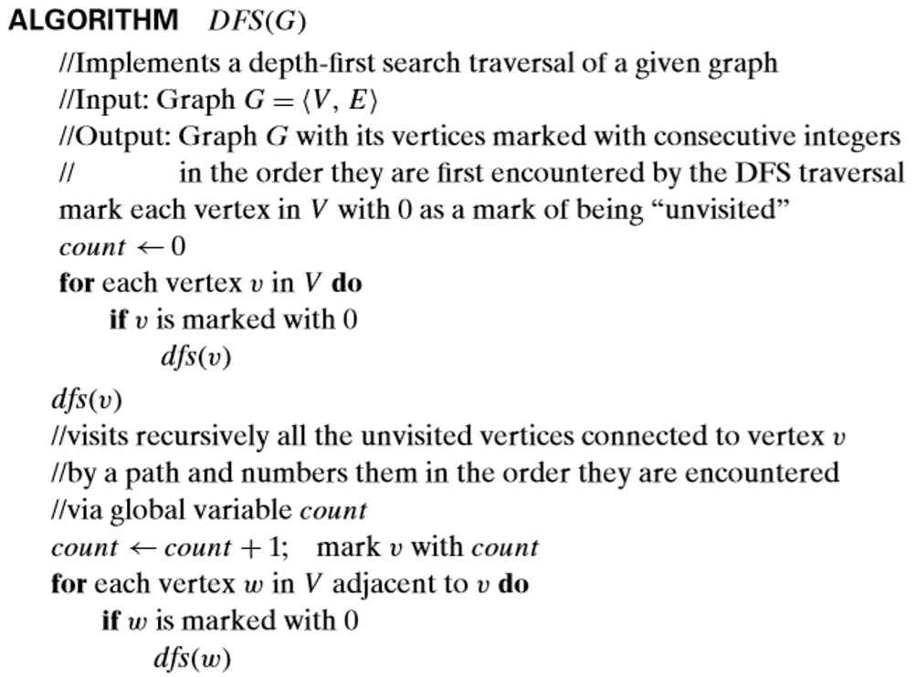
DEPTH- first search (dFS) Algorithm

Slide 38
In-Class Practice 5
What is the order that these vertices are visited when starting with vertex ‘A’, using DFS method of traversal, and resolving ties alphabetically?

Slide 39
Graph algorithms

Slide 40
Graph algorithms
Dijkstra’s Shortest Path
Topological Sort
Minimum Spanning Tree

Slide 41
Dijkstra’s Shortest Path
Dijkstra’s algorithm finds the shortest path to all vertices in a weighted (> zero) directed or undirected graph.
This is a single-source-shortest-path problem. The solution is a family of paths, each leading from the source to a different vertex in the graph.
Applications:
Transportation planning
Packet routing in communication networks

Slide 42
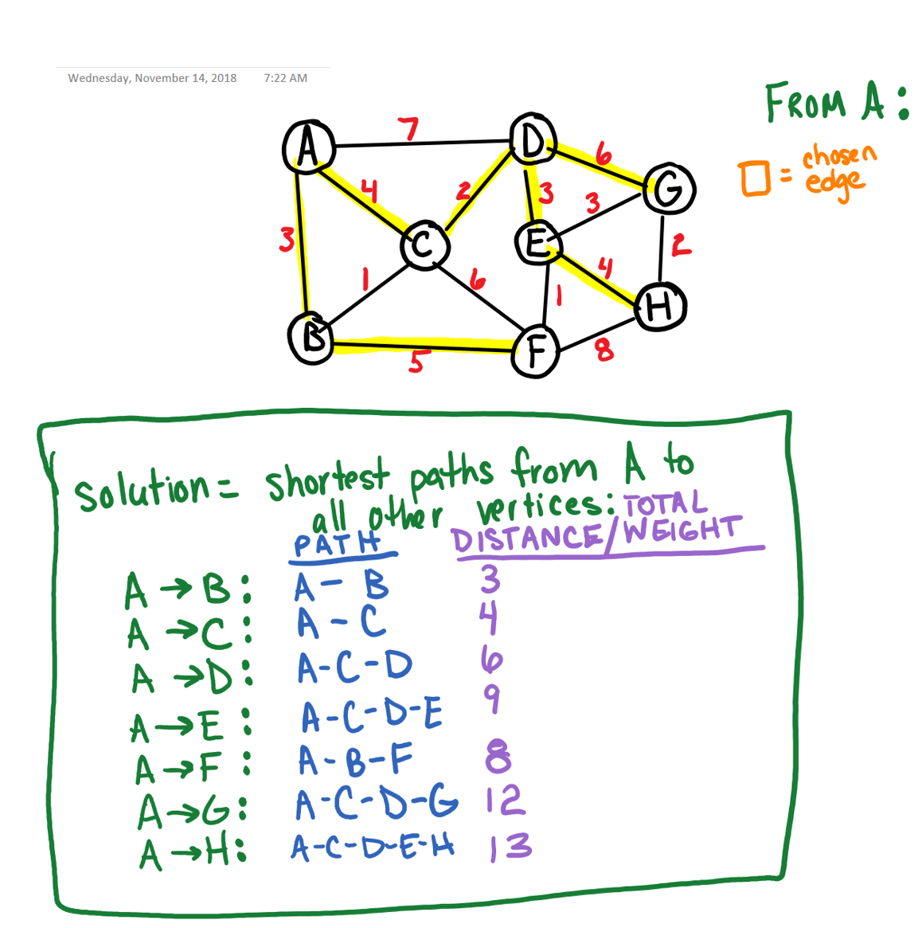
Dijkstra’s Shortest Path

Slide 43
Topological Sort
Topological sorting of vertices of a directed graph (digraph) is an ordering of the vertices in a specific way.
The vertices of the graph may represent tasks to be performed, and the edges may represent constraints that one task must be performed before another
You can’t topologically sort a graph that has cycles. The graph must be a Directed Acyclic Graph (DAG)
Applications (anything where one thing has to be done before another)
Course prerequisites – which courses should you take next semester?
Construction of house, furniture, rockets, airplanes, cars, etc.
Project scheduling
Processors: instruction scheduling
Makefiles

Slide 44
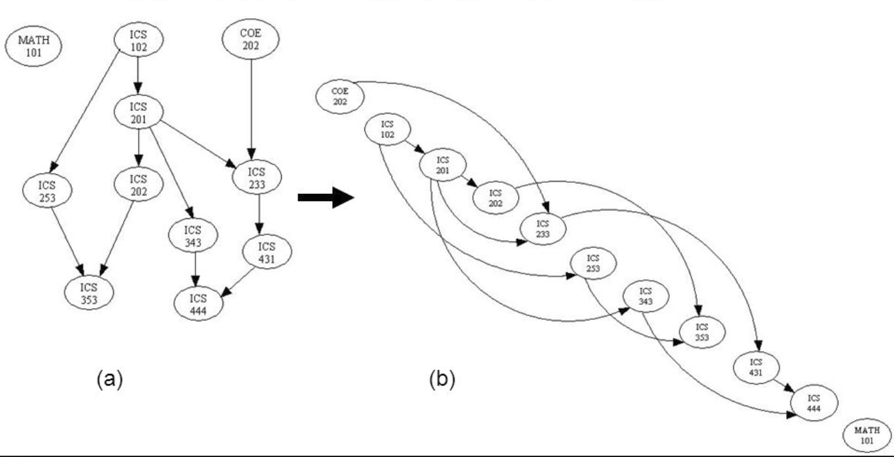
Topological sort
Course Prerequisite Example:

Slide 45
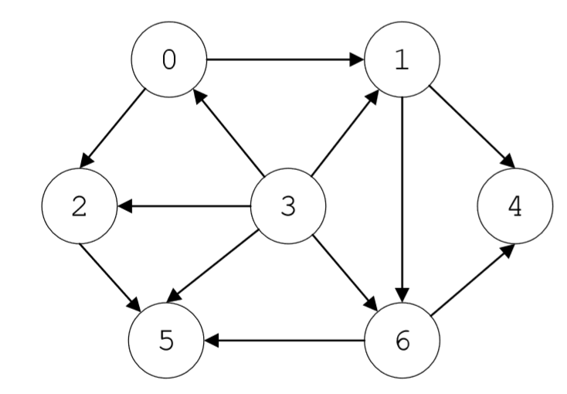
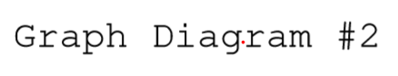
Topological sort
One way to topologically sort a graph is to use Depth First Search, sort the vertices in order of the way they are popped off the stack, and then reverse that.
This graph topologically sorted is: 3 0 2 1 6 5 4

Slide 46
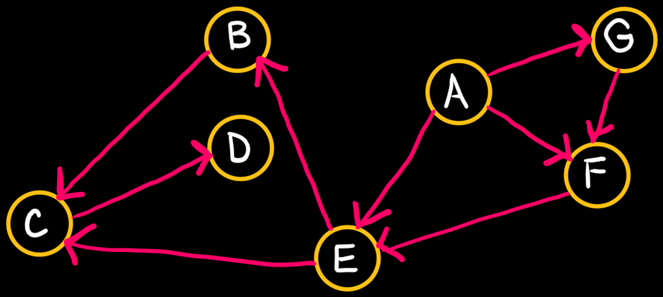
In-Class Practice 6
What is the topological sort of this graph when starting with vertex ‘A’, using DFS method of traversal, and resolving ties alphabetically?

Slide 47
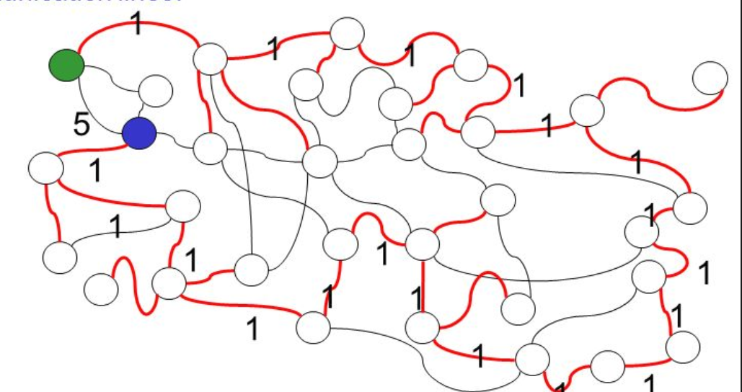
Minimum spanning tree
A minimum spanning tree is a subset of an undirected acyclic graph that contains all vertices of the graph and has the smallest weight of all other spanning trees of the graph. Weight is the sum of all edges in the spanning tree.
Example: Find the least expensive way to connect a set of towns cell towers with power/communication lines. It may not be the shortest path!

Slide 48
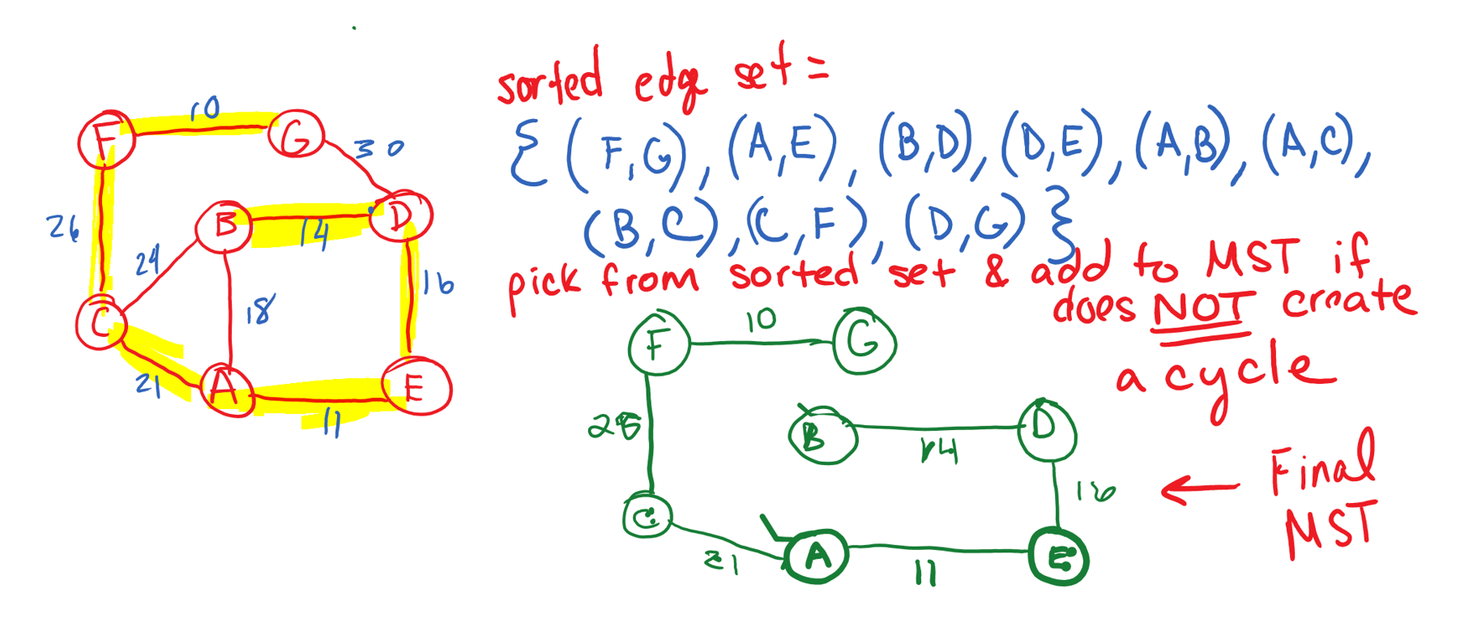
Minimum spanning tree
Prims & Kruskals algorithms both solve the minimum spanning tree problem.
Example of Kruskals: (1) SORT EDGEST BY WEIGHT (2)PICK FROM SORTED LIST AND ADD TO MST SOLUTION IF DOESN’T FORM A CYCLE
Diagram 15A & 15B

Slide 49
done

